Slide 1
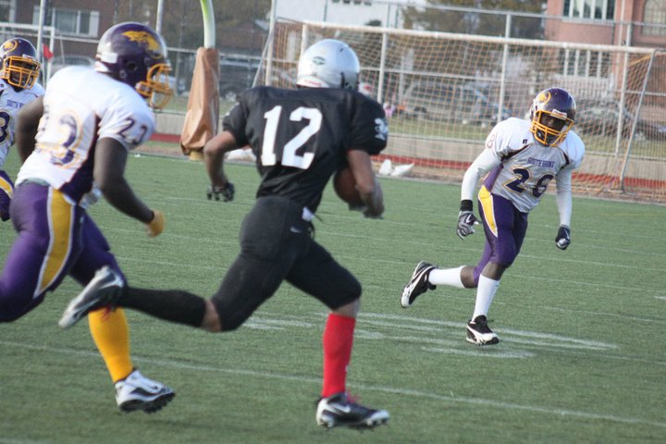
My FUTURE IT KIT Things I need in the future
By: Andre Suwuh
Digital Electronics PD 2

Slide 2
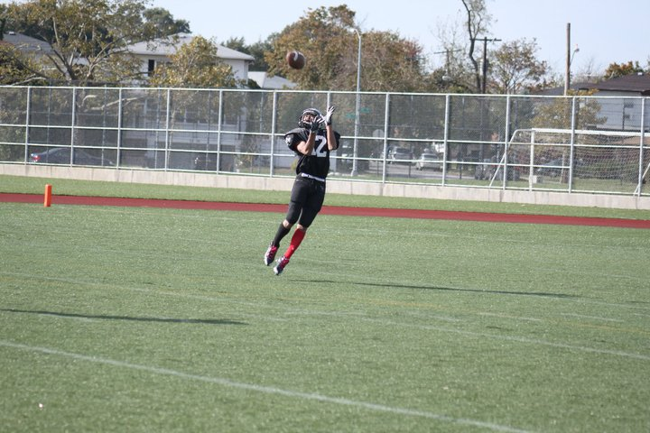
Who am I?
Name: Andre Suwuh
Nickname: Ninja Turtle
D.O.B: Aug.17.1995
Nationality: Indonesian
Race: somewhat Asian/Hawaiin
Goal: succeed in life and get a degree in mechanical engineering. Most of all I just want to make it to the NFL and play some football.

Slide 3
THE FUTURE ME
So in the future I'm going to be an NFL player doing it big and getting tons of money. I rely on my IT needs to do assignments for me from my boss or maybe i just want to just talk to my relatives.

Slide 4
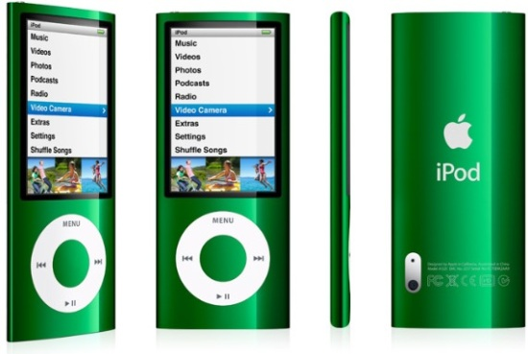
IT needs☺
Apple Ipod Nano green
Entertainment and listening to it on the go.
Price:150$

Slide 5
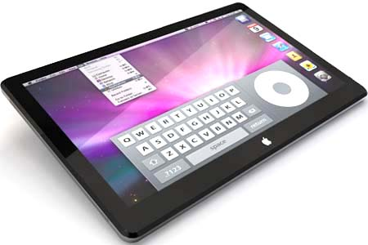
IT needs☺
Apple Ipad 2
Entertainment/Work
Very light and thin. It is very fast and has
the power of a computer. It also has
facetime
Price:499$

Slide 6
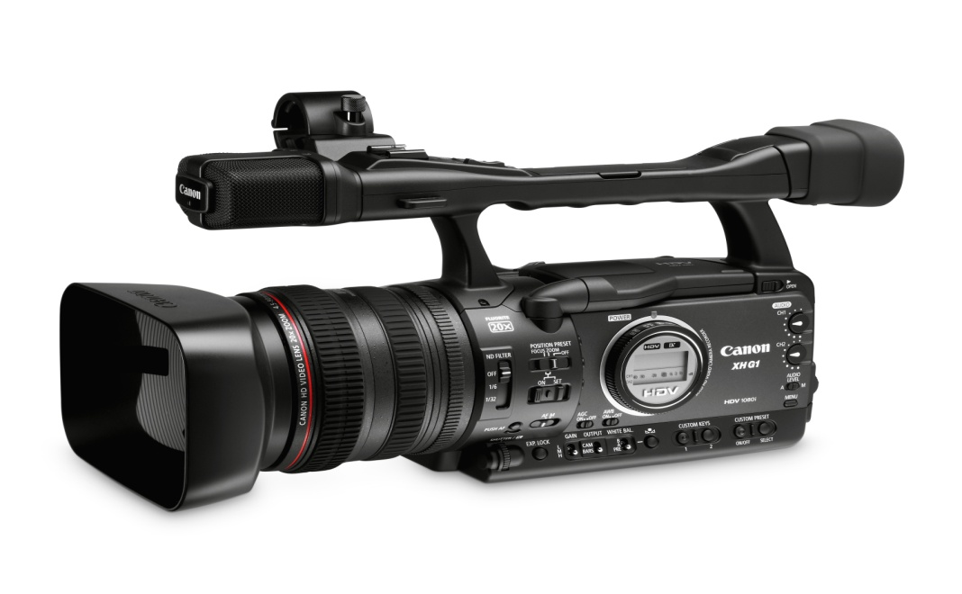
IT needs☺
Canon XH G1 S HD
Work
Recording my football plays and highlights for the
coaches to review how well I did on the field in
games and in practice.
A canon video/camera with HIDEF and 1080p when you record.
Price: 5,732$

Slide 7
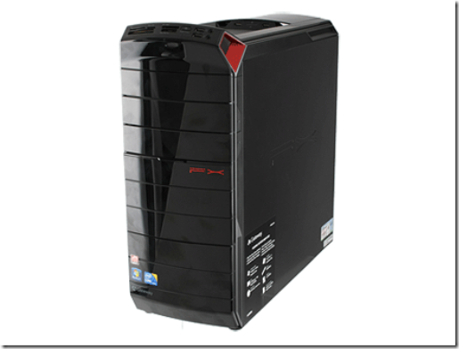
IT needs☺
Gateway FX 6831-01
Work and Entertainment
8GB RAM. 2.8 GHz. 1.5TB HDD Corei7-860
processor with L3 cache and Turbo boost.
To do work and use this device to communicate with
my boss, teamates and family.
Price: 1,900$

Slide 8
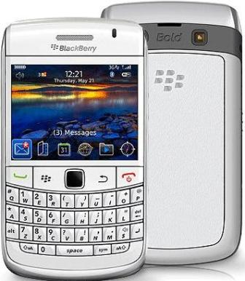
IT needs☺
Research in Motion Blackberry Bold White
Communication
9700 and has bluetooth. I can talk with
others, and has a 3.5 megapixel.
communicating with my family and my boss to
tell them where im at and if I have football
practice, meeting, etc.
Price: 299$

Slide 9
The End
Mr. Beder Please Give me 100☺
(Please Clap)

